Slide 1
Fractals
Ignite
Possibilities

Slide 2

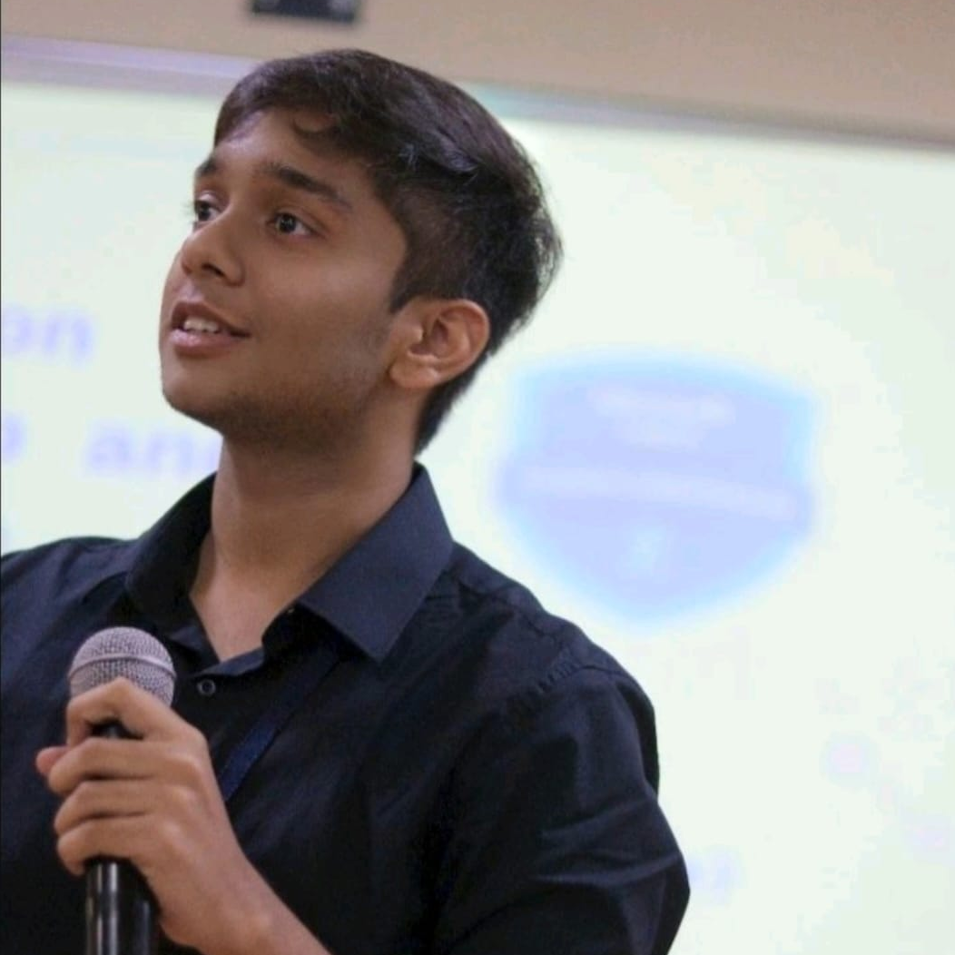


TEAM FRACTALS
PS-11 Intel Products Sentiment Analysis from Online Reviews
GARV
BHASAR
AVIRAL
SRIVATSAVA
DINESH
KUMAR
HARINI S
Student
Student
Student
Mentor
Institution: Vellore Institute of Technology, Chennai

Slide 3
Contributions
Garv Bhaskar
Word2Vec:
Developed Word2Vec models to generate meaningful word embeddings from the textual data. - Enhanced the semantic understanding of customer reviews for improved sentiment analysis.
LSTM’s:
Implemented Long Short-Term Memory (LSTM) networks to capture temporal dependencies in the data. - Improved prediction accuracy by leveraging the sequential nature of customer reviews.
Summaries:
Generated concise summaries of customer reviews to highlight key sentiments and opinions.
Predictions:
Predicted on unseen data using LSTM models trained.
Scrapy Webscraping:
Built and optimized a Scrapy web scraper to efficiently extract product reviews from Amazon
Compiled the Performance Analysis between utilizing Transformer and LSTM’s.
Aviral Srivastava
Data Exploration:
Conducted data exploration to understand the structure and distribution of reviews. Generated insightful visualizations to uncover patterns and trends in customer feedback.
Data Preparation:
Implemented data cleaning techniques, like removal of HTML tags, punctuation, and stopwords. Applied stemming and lemmatization to standardize the textual data.
Bag of Words Approach:
Transformed textual data into structured numerical format. Enabled efficient feature extraction to support advanced machine learning algorithms.
Insights using WordCloud:
Created word clouds to visually represent the most frequent terms in customer reviews. Provided actionable insights into customer sentiments and key areas of focus.
GitHub Documentation:
Developed comprehensive GitHub documentation. Ensured clear communication of project objectives, methodologies, and results to the wider audience.
Compiled the Key Takeaways on Processor Strengths and Weaknesses for Intel Engineers
Dinesh Kumar
Project Report :
Compiled the Project Report in IEEE Research Paper format.
Slides Deck :
Prepared the initial slides deck for the project presentation.

Slide 4
Introduction
Scope of the project
Data sources used
Data scraping process
Data Exploration & Visualization
Data Preparation
Model Comparison
Approaches: Bag of Words, Word2Vec, LSTM
Word Clouds
Summarizing the Reviews
Key Takeaways for Intel Engineers
Analysis Of LSTM and Transformer Performance
Table of Content

Slide 5
Challenge awaiting resolution
Problem:
Perform sentiment analysis on customer reviews of Intel products scraped from Amazon and other platforms
What is the purpose behind this action?
What approach are we taking to accomplish it?
Who stands to gain the resolution of this problem?

Slide 6
Web Scraping
Aspect based analysis
Data processing
Product
Sentiment
Analysis
Trend analysis
NLP techniques
Insights

Slide 7
Sentiment Distribution
Hypothetical Percentages for Sentiment Categories
50 PERCENT
35 PERCENT
15 PERCENT
POSITIVE
REVIEWS(4-5)
NEGATIVE
REVIEWS(1-2)
NEUTRAL
REVIEWS(3)
Reviews that express satisfaction and positive experiences with Intel products.
Reviews that highlight dissatisfaction or negative experiences with Intel products.
Reviews that are neither explicitly positive nor negative, often containing mixed sentiments or factual comments without strong emotional indicators.

Slide 8
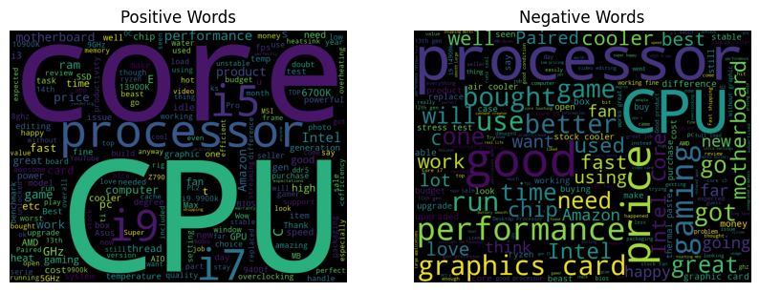
Our proposed solution to address the challenge:
Our proposed solution for sentiment analysis integrates TF-IDF(Term Frequency-Inverse Document Frequency) vectorization with Logistic Regression for baseline performance evaluation, leveraging Word2Vec embeddings initialized within an LSTM(Long Short Term Memory) architecture for enhanced semantic understanding.
The process begins with tokenization, cleaning using NLTK(Natural Language ToolKit), and feature extraction using TF-IDF to handle word frequency and importance scaling.
We fine-tune Logistic Regression parameters via GridSearchCV and train an LSTM model in Keras with pretrained Word2Vec embeddings to capture nuanced semantic meanings in reviews.
Evaluation involves metrics like accuracy and visualization through word clouds to interpret impactful words influencing sentiment predictions.
Deployment includes monitoring to ensure continuous model optimization and reliability in real-world applications.

Slide 9
Strength
Weakness
Advanced NLP Techniques
Scalability
Semantic Understanding
Interpretability
Customization
Computational Intensity
Data Dependence
Model Interpretability
Overfitting Risk
S
W
T
O
Threat
Opportunity
Data privacy Concerns
Technological Obsolescence
Market Volatility
Competitive Landscape
Industry Adoption
Continuous Innovation
Personalization
Integration With AI Solutions
Global Market Expansion

Slide 10
SCOPE OF THE PROJECT
STEP
STEP
STEP
1
2
3
DATA EXPLORATION
DATA PREPARATION
BAG OF WORDS
Visualize distributions, analyze statistical summaries, and identify any patterns or anomalies in the dataset that could impact model training and evaluation.
Normalize text (lowercase), handle missing values, tokenize sentences into words, and split data into training and testing sets for model development.
Apply techniques such as Tfidf- Vectorizer from sklearn to transform
raw text into a sparse matrix suitable for machine learning models like Logistic Regression.
STEP
STEP
STEP
4
5
6
WORD2VEC
LSTM
WORD CLOUD
Tokenize text into sentences, train Word2Vec embeddings using gensim, and transform each review into average feature vectors of its constituent words for downstream tasks like classification.
Tokenize text, pad sequences to ensure uniform length, construct LSTM models with Keras, compile with appropriate loss and optimizer, and train on the prepared dataset.
Tokenize text, filter stopwords, and generate separate word clouds for positive and negative sentiment reviews using libraries like nltk and wordcloud for insightful visualization.

Slide 11



DATA SOURCES USED
Kaggle Datasets
Publicly available datasets from Kaggle, including product reviews from Amazon, Yelp, and IMDb, were used to train and evaluate our models.. https://www.kaggle.com/datasets/alanjo/amd-processor-specifications
POINT
01
Public Repositories
POINT
03
Additional data came from the UCI Machine Learning Repository and GitHub, which host various datasets suitable for sentiment analysis.. Link: https://github.com/toUpperCase78/intel-processors
POINT
03
Web Scraping
Real-time reviews were collected from various e-commerce websites and social media platforms using web scraping tools like BeautifulSoup and Scrapy.. The webscraping tool is named as amaze. Check the github repository. https://github.com/GarvBhaskar/Intel-Product-Sentiment-Analysis
POINT
02

Slide 12


DATA SCRAPING PROCESS
Identify Target Websites
We selected e-commerce platforms and social media sites where user reviews and comments are frequently posted.
POINT
01
Handling Pagination
Many review pages are spread across multiple pages. Scripts were written to navigate through paginated content to ensure comprehensive data collection.
Use of Scraping Tools
POINT
04
Tools like BeautifulSoup and Scrapy were employed to parse HTML and extract relevant data. Selenium was used for dynamic content loading.
POINT
02
Data Cleaning and Storage
Collected data was cleaned to remove HTML tags, special characters, and irrelevant information. The cleaned data was then stored in structured formats such as CSV files or directly into databases for further processing.
Extracting Data
POINT
05
We focused on extracting key elements such as review text, ratings, dates, and user details. CSS selectors and XPath were used to pinpoint the exact locations of these elements within the HTML structure.
POINT
03

Slide 13
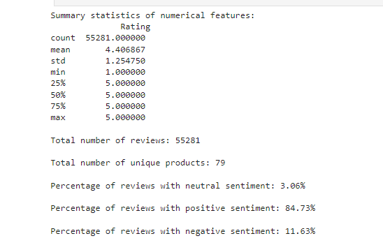
Data Exploration
DATA EXPLORATION
In the data exploration phase, we analyzed sentiment label distribution for balance, visualized brand-specific rating distributions, and examined statistical summaries of review lengths. These insights guided subsequent data preparation and modeling efforts effectively.

Slide 14
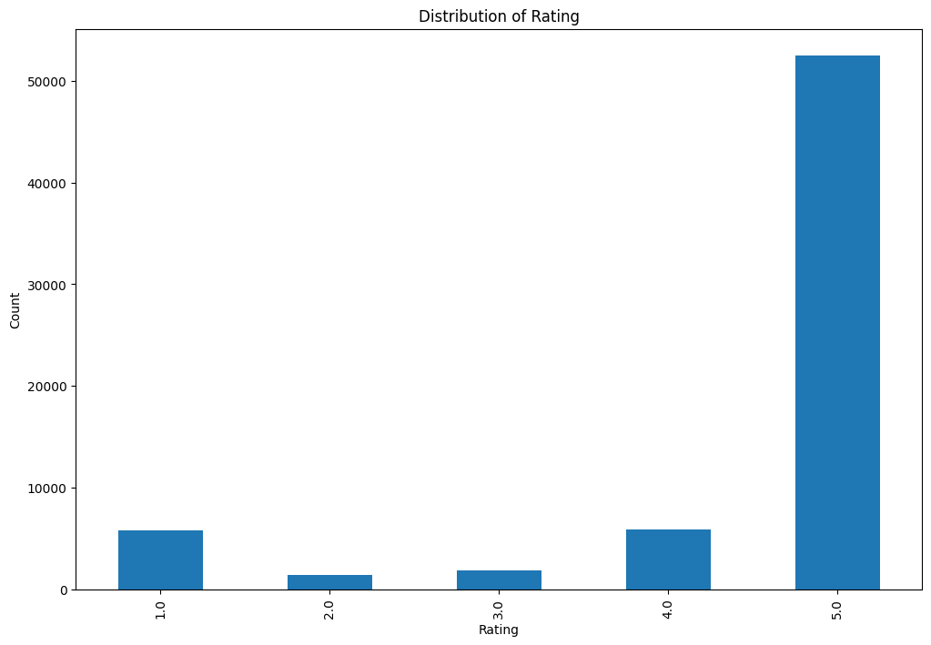
Data Visualization
Plot distribution of rating

Slide 15
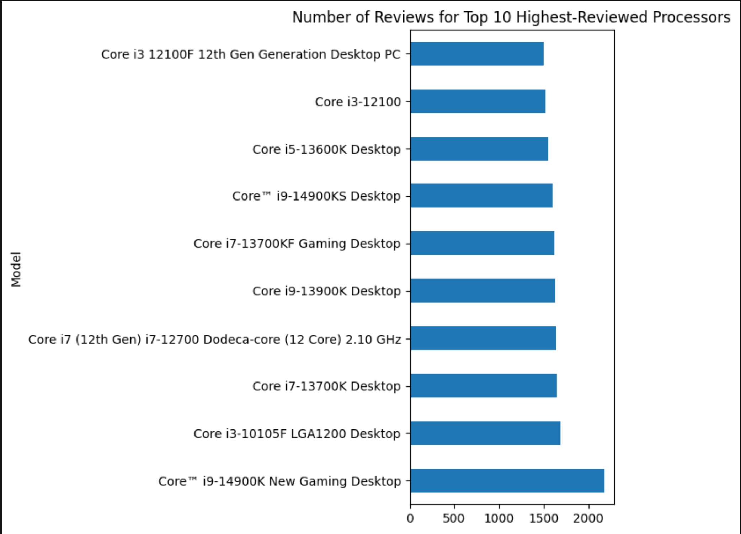
Data Visualization
Plot number of reviews for top 10 Highest reviewed processors

Slide 16
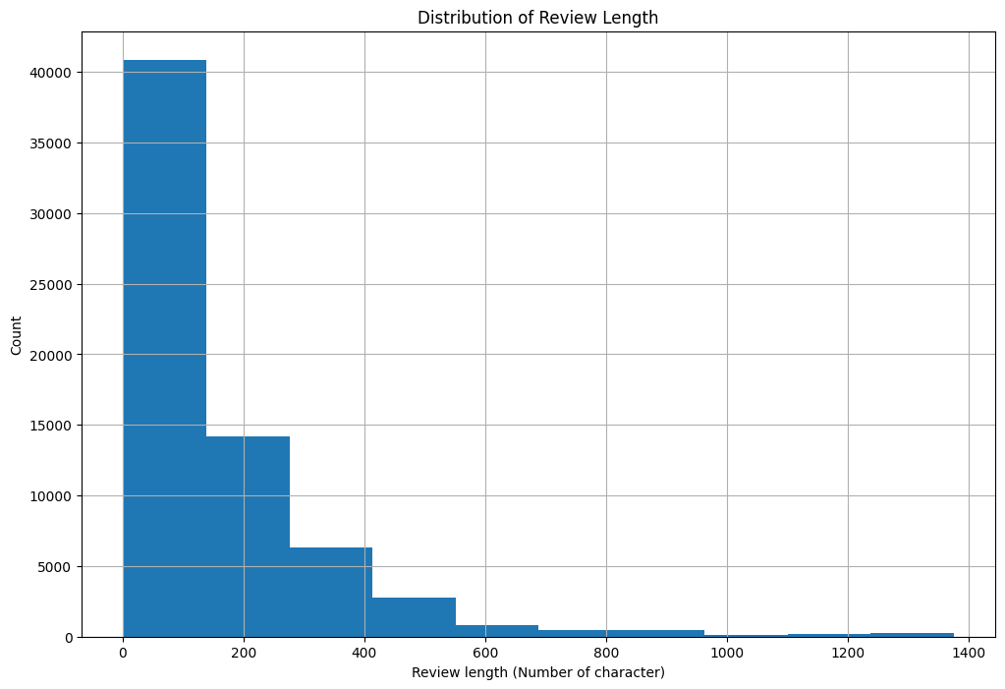
Data Visualization
Plot distribution of Review Length

Slide 17
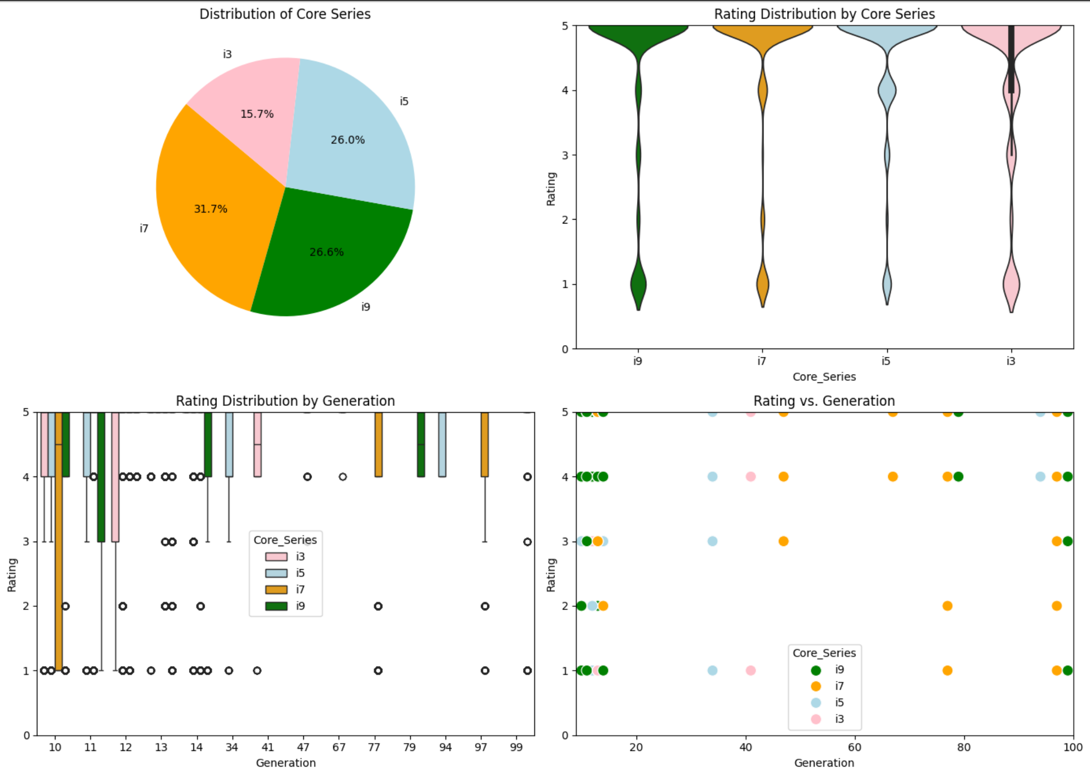
Data Visualization

Slide 18
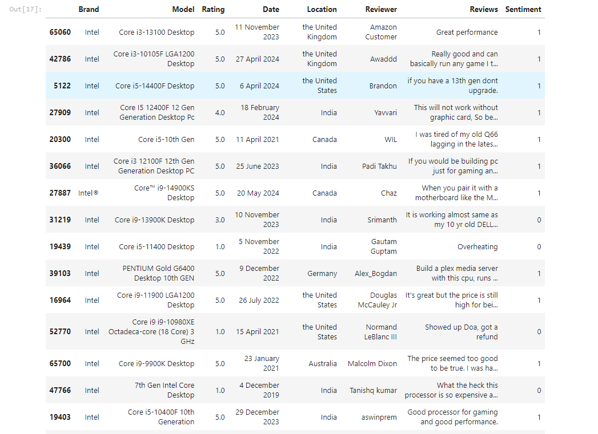
Data Preparation
DATA PREPARATION
During data preparation, we focused on cleansing and tokenizing textual reviews, addressing punctuation and stop words, and converting reviews into numerical formats suitable for various models like Bag of Words and Word2Vec. This ensured our data was primed for analysis and model training in natural language processing tasks.

Slide 19
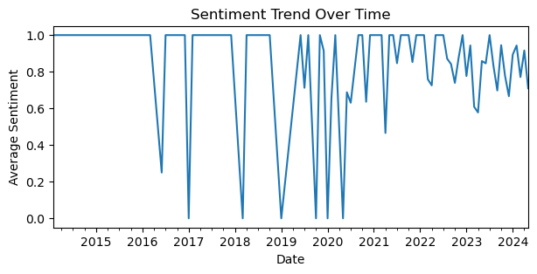
Data Visualization
Plot the sentiment trend over time

Slide 20
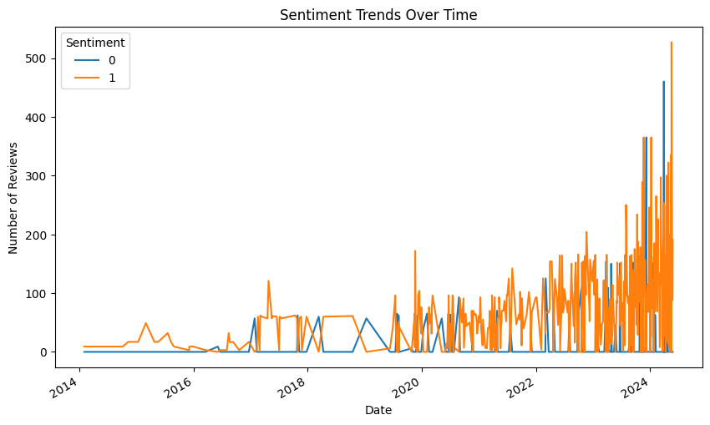
Data Visualization
Plot the sentiment trends over time

Slide 21
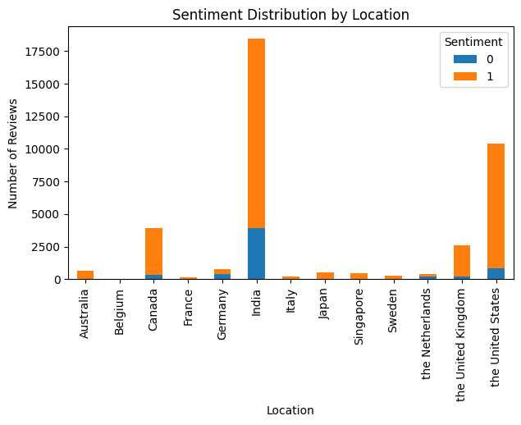
Data Visualization
Plot the sentiment counts for each location

Slide 22
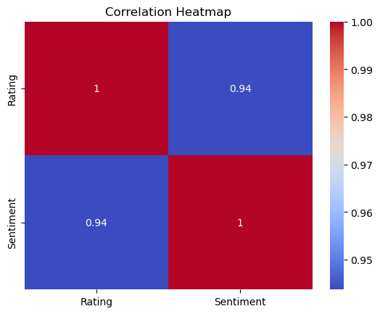
Data Visualization

Slide 23
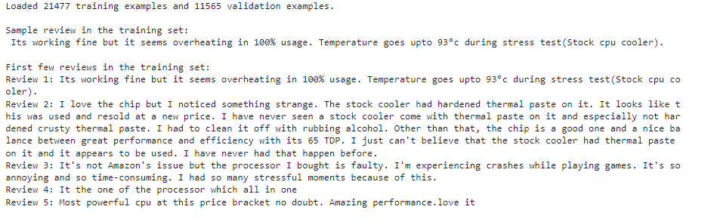
Data Exploration
DATA EXPLORATION
In the data exploration phase, we analyzed sentiment label distribution for balance, visualized brand-specific rating distributions, and examined statistical summaries of review lengths. These insights guided subsequent data preparation and modeling efforts effectively.

Slide 24
BAG OF WORDS
Text Preprocessing
Preprocess raw reviews to cleaned reviews: Remove noise, handle capitalization, punctuation, and stopwords, and perform stemming or lemmatization to standardize text.
POINT
01
Fit feature Vectors
Fit feature vectors to supervised learning algorithm (eg. Naive Bayes, Logistic regression, etc.): Train a supervised learning model such as Naive Bayes or Logistic Regression using the numerical feature vectors and corresponding sentiment labels.
CounterVectorizer/TfidfVectorizer
POINT
04
Create BoW using CountVectorizer / TfidfVectorizer in sklearn: Tokenize the cleaned text data into words or n-grams, build a vocabulary of unique tokens, and compute token frequencies or TF-IDF weights.
POINT
02
Gridsearch
Improve the model performance by GridSearch: Optimize model hyperparameters through GridSearchCV to achieve better accuracy and generalization, tuning parameters such as regularization strength, n-gram range, and vectorizer options.
Feature Vectors
POINT
05
Transform review text to numerical representations (feature vectors): Convert each review into a numerical vector representation using the Bag of Words approach, where each dimension represents a token or n-gram.
POINT
03

Slide 25


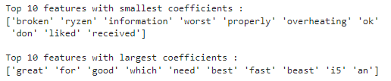
Model Comparison
CountVectorizer with Mulinomial Naive Bayes (Benchmark Model)
In sklearn library, we can use CountVectorizer which implements both tokenization and occurrence counting in a single class. The output is a sparse matrix representation of a document.
.
TfidfVectorizer with Logistic Regression
In sklearn library, we can use TfidfVectorizer which implements both tokenization and tf-idf weighted counting in a single class.
.
Pipeline and GridSearch
In sklearn library, we can build a pipeline to streamline the workflow and use GridSearch on the pipeline model to implement hyper-parameter tuning for both vectorizer and classifier in one go.
.

Slide 26
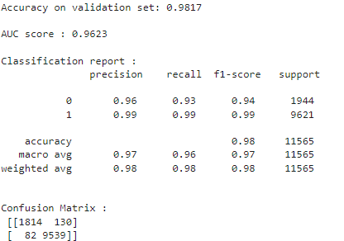
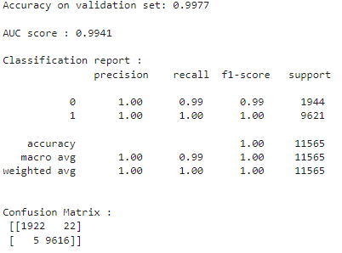
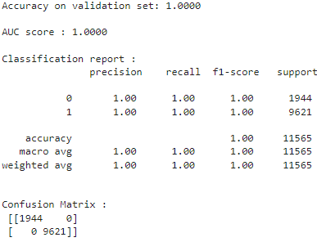
Model Comparison
CountVectorizer with Mulinomial Naive Bayes (Benchmark Model)
TfidfVectorizer with Logistic Regression
Pipeline and GridSearch

Slide 27
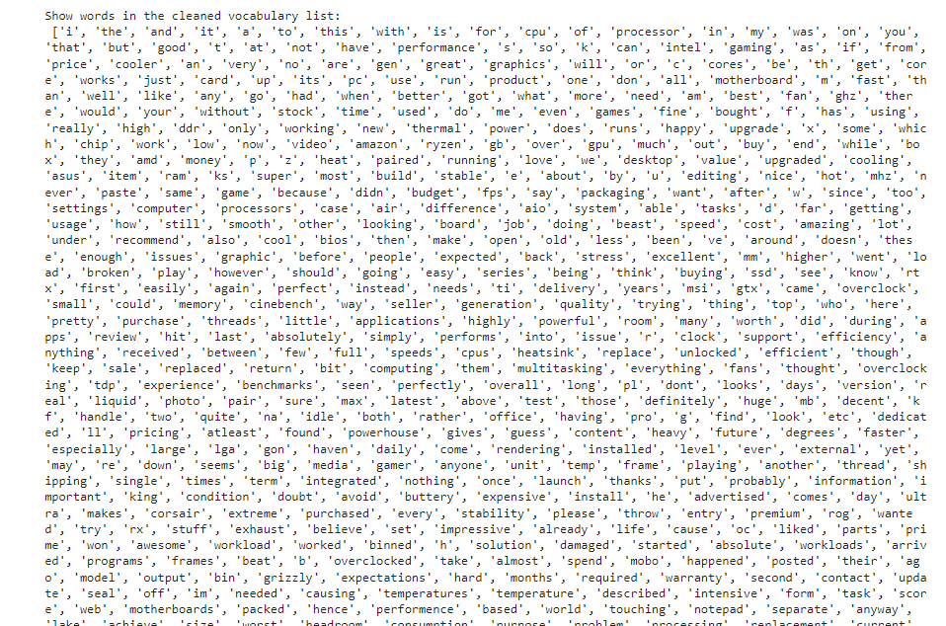
Word2Vec
Step 1: Parse reviews into sentences: Tokenize each review for Word2Vec model input.
Step 2: Build vocabulary with Word2Vec: Create a vocabulary list using Word2Vec embeddings.
Step 3: Convert reviews to numerical vectors: Compute average feature vectors for each review.
Step 4: Train Random Forest: Use average vectors to train a Random Forest Classifier.
Show words in the cleaned vocabulary list

Slide 28
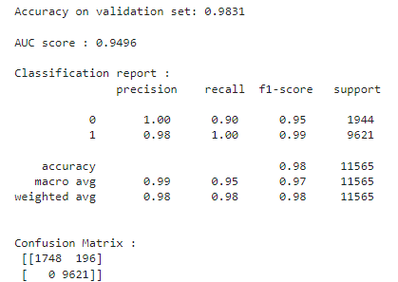
Word2Vec
Now we have created a vocabulary list of words, with each word having a word representation (ie. feature vector of dim 300)
To find a numerical representation for a review, we run through each word in a review text. For words appear in the vocabulary list, we compute the average feature vectors of all those words. The average feature vector is the numerical represenation of the review.
Random forest classifier
Averaging Feature Vectors

Slide 29
Steps to Train a Simple LSTM Model
Model Compilation
Data Preprocessing
Model Evaluation
Tokenize and pad the text corpus to convert reviews into fixed-length numerical sequences.
Compile the model using binary cross-entropy loss, Adam optimizer, and accuracy metric.
Evaluate model performance on test data using metrics such as loss and accuracy to assess its effectiveness in sentiment classification.
Model Definition
Model Training
Build a Sequential model with an Embedding layer for word-to-vector mapping, an LSTM layer with 128 units for learning sequence dependencies, and a Dense output layer with softmax activation for sentiment classification.
Fit the model on training data with specified batch size and epochs to optimize model parameters.

Slide 30
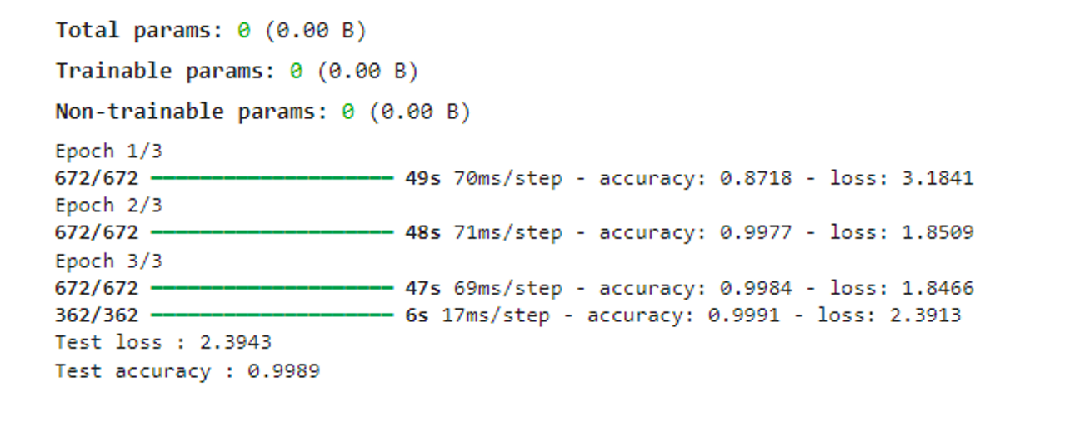
LSTM
we use the Word2Vec embedding trained in Part 4 to intialize the weights of embedding layer in LSTM.
Step 1 : Load pretrained word embedding model
Step 2 : Construct embedding layer using embedding matrix as weights
Step 3 : Train a LSTM with Word2Vec embedding (embeddign layer => LSTM layer => dense layer)
Step 4 : Compile and fit the model using log loss function and ADAM optimizer

Slide 31
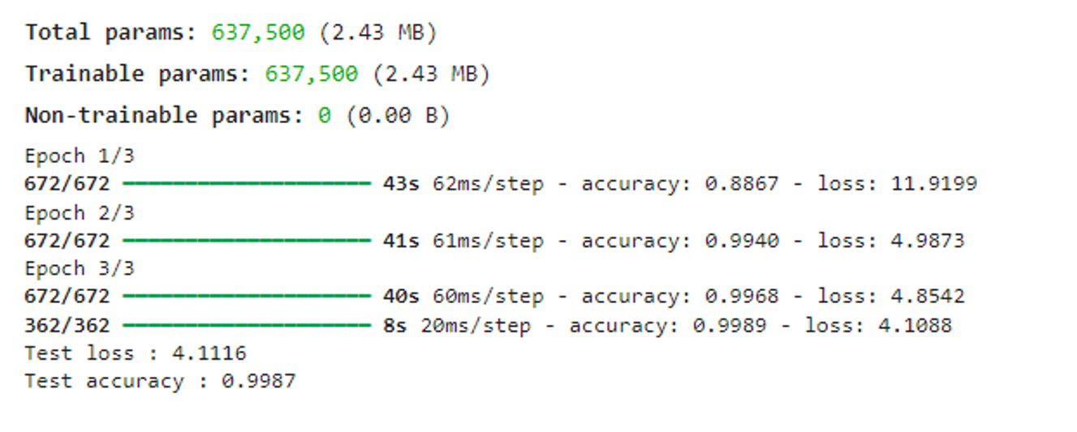
LSTM with Word2Vec Embedding
Instead of using random weights, we can use pretrained word embeddings to initialize the weight of an embedding layer. In this part, we use the Word2Vec embedding trained in Part 4 to intialize the weights of embedding layer in LSTM.
Step 1 : Load pretrained word embedding model
Step 2 : Construct embedding layer using embedding matrix as weights
Step 3 : Train a LSTM with Word2Vec embedding (embeddign layer => LSTM layer => dense layer)
Step 4 : Compile and fit the model using log loss function and ADAM optimizer

Slide 32
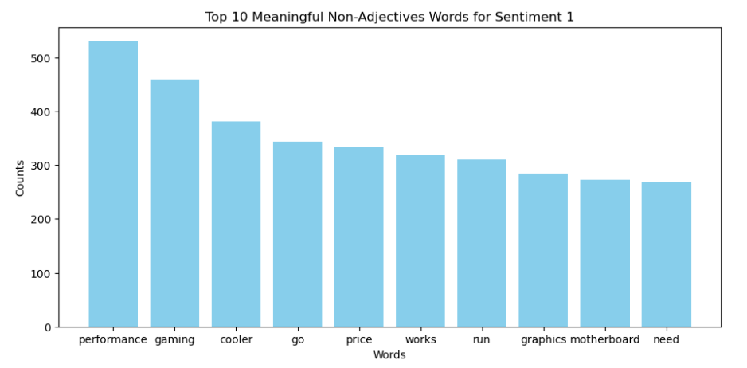
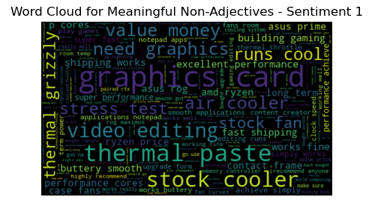
WORD CLOUD

Slide 33
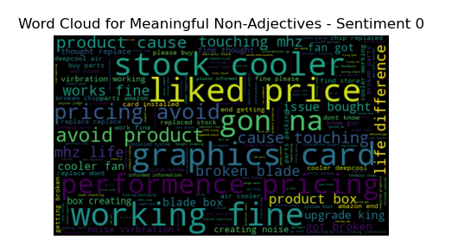
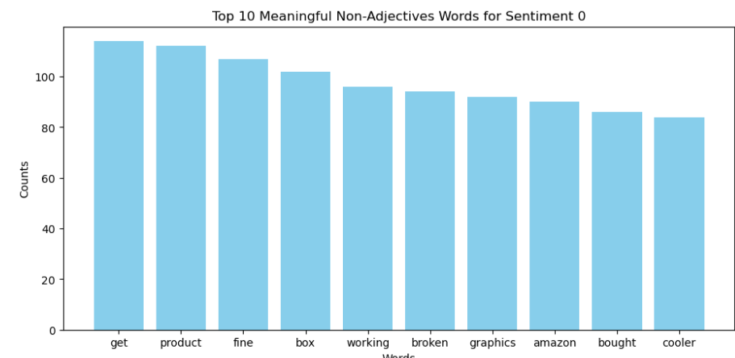
WORD CLOUD

Slide 34
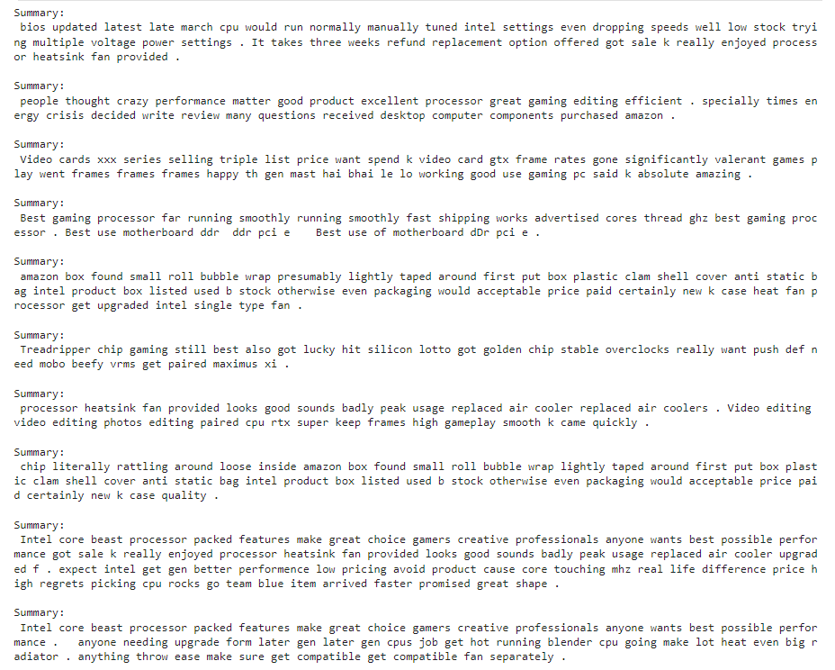
SUMMARIZING THE REVIEWS

Slide 35
Key Takeaways for Intel Engineers
Positive Aspects:
1. Performance and Efficiency:
- Intel processors are praised for their excellent performance in gaming, video editing, and other demanding applications.
- The energy efficiency of Intel processors is particularly appreciated, especially during times of energy crisis.
2. Customer Satisfaction:
- Users report high satisfaction with the smooth running and fast performance of Intel processors.
- Many customers highlight the processors as the best choice for gaming and creative professionals.
3. Features and Compatibility:
- Intel processors are valued for their compatibility with various motherboards and components.
- Features like multiple cores and high GHz ratings are highly regarded.
4. Customer Experience:
- Positive reviews often mention the enjoyable process of upgrading to Intel processors and the efficient performance once installed.

Slide 36
Key Takeaways for Intel Engineers
Negative Aspects:
1. Delivery and Packaging Issues:
- Some customers experienced poor packaging, with processors rattling around loose inside the box or inadequately protected by bubble wrap.
- Instances of receiving used or B-stock products instead of new items have been reported.
2. Quality Control:
- There are complaints about receiving defective or dysfunctional processors.
- Customers have faced issues with processors not performing as expected, requiring multiple adjustments to settings.
3. Performance Concerns:
- Overheating and the need to replace the stock heatsink fan with more efficient air coolers have been mentioned.
4. Cost vs. Performance:
- Some customers feel the high price of Intel processors does not always match the performance gain, leading to buyer’s remorse.

Slide 37
Analysis Of LSTM and Transformer Performance
LSTM Result
LSTMs are well-suited for tasks to predict the Sentiment and classify the sentences that got them there. Our LSTM model predicts the future unseen Reviews as Positive or Negative.
LSTM’s struggle with deciphering extra information and differentiating between recommendations.
TRANSFORMER Result
Transformers help in handling long sequences, extracting information and learning from that information.
They can give information about what is given in the data, for example the results from out summaries.

Slide 38
Thank You

